Slide 1
Turunan fungsi tangen, kotangen, sekan dan kosekan
By
Siti syarah maulydia, m.pD

Slide 2

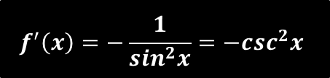





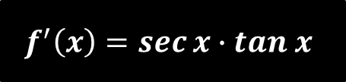
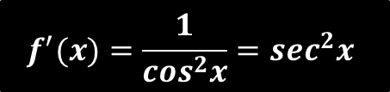


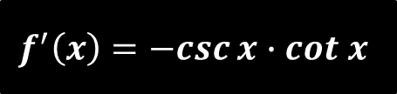
TURUNAN FUNGSI TRIGONOMETRI
$$f\left(x\right)=\sin{x}$$
$$f′\left(x\right)=\cos{x}$$
$$f\left(x\right)=\cos{x}$$
$$f′\left(x\right)=−sin{x}$$
$$f\left(x\right)=\tan{x}$$
$$f^{′}(x)=\frac{1}{\cos^{2}x}=\sec^{2}x$$
$$f\left(x\right)=\cot{x}$$
$$f^{′}\left(x\right)=−\frac{1}{\sin^{2}x}={−csc}^{2}x$$
$$f\left(x\right)=\sec{x}$$
$$f^{′}\left(x\right)=\sec{x}∙tan x$$
$$f\left(x\right)=\csc{x}$$
$$f^{′}\left(x\right)=−csc{x}∙cot x$$

Slide 3



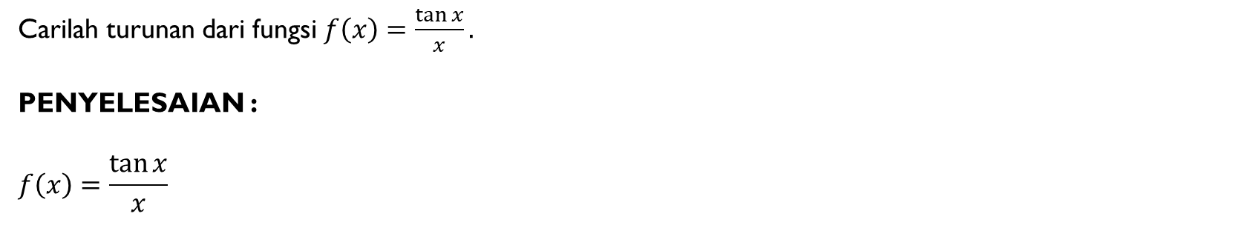



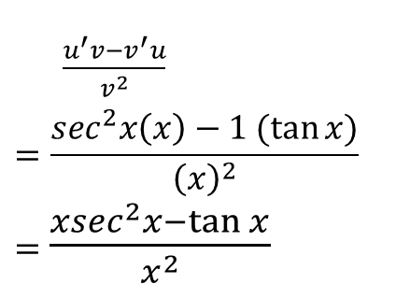
CONTOH NO. 1
Carilah turunan dari fungsi $f\left(x\right)=\frac{\tan{x}}{x}.$
PENYELESAIAN :
$$f\left(x\right)=\frac{\tan{x}}{x}$$
Misalkan : $u=\tan{x}$
$v=x$
$$→u^{′}=$$
$$\sec^{2}x$$
$$→v^{′}=$$
$$1$$
$\frac{u^{′}v−v^{′}u}{v^{2}}$
$$=\frac{\sec^{2}x\left(x\right)−1 (\tan{x)}}{{\left(x\right)}^{2}}$$
$=$ $\frac{{xsec}^{2}x−\tan{x}}{x^{2}}$
$$f^{′}\left(x\right)=$$

Slide 4



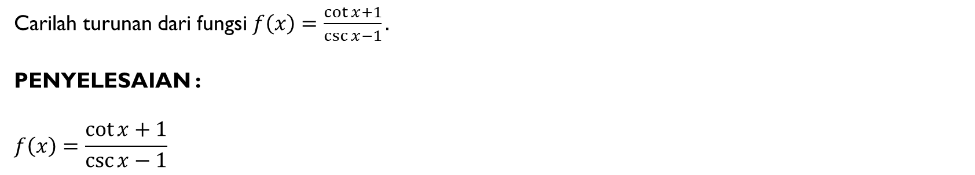



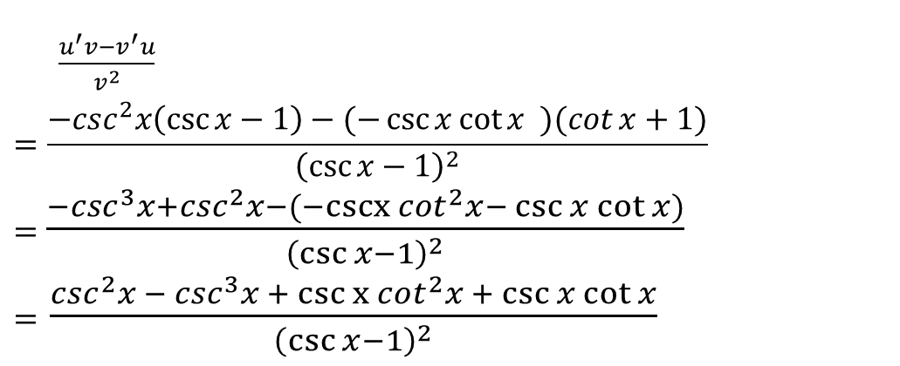
CONTOH NO. 2
Carilah turunan dari fungsi $f\left(x\right)=\frac{\cot{x}+1}{\csc{x}−1}.$
PENYELESAIAN :
$$f\left(x\right)=\frac{\cot{x}+1}{\csc{x}−1}$$
Misalkan : $u=\cot{x}+1$
$v=\csc{x−1}$
$$→u^{′}=$$
$${−csc}^{2}x$$
$$→v^{′}=$$
$$−\csc{x\cot{x}}$$
$\frac{u^{′}v−v^{′}u}{v^{2}}$
$$=\frac{{−csc}^{2}x\left(\csc{x−1}\right)−(−\csc{x\cot{x}} )(\cot{x}+1\text{)}}{{\left(\csc{x−1}\right)}^{2}}$$
$=$ $\frac{{−csc}^{3}x+\csc^{2}x−(−cscx \cot^{2}x−{\csc{x\cot{x}}})}{{\left(\csc{x−1}\right)}^{2}}$
$=$ $\frac{\csc^{2}x − \csc^{3}x + csc x \cot^{2}x + \csc{x\cot{x}}}{{\left(\csc{x−1}\right)}^{2}}$
$$f^{′}\left(x\right)=$$

Slide 5
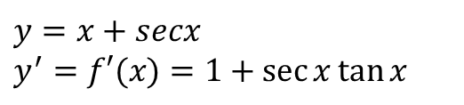
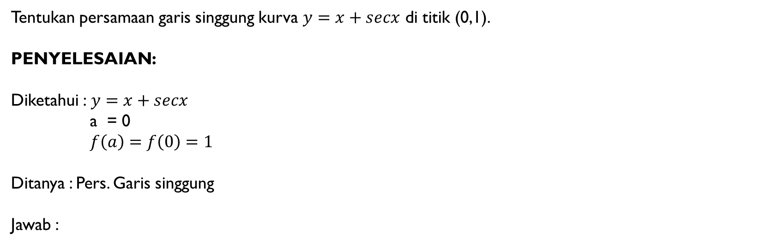

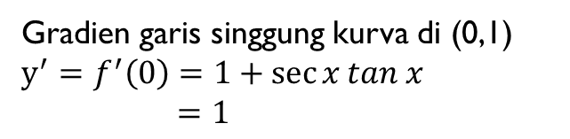
CONTOH NO. 3
Tentukan persamaan garis singgung kurva $y=x+secx$ di titik (0,1).
PENYELESAIAN:
Diketahui :$y=x+secx$
a = 0
$f\left(a\right)=f\left(0\right)=1$
Ditanya : Pers. Garis singgung
Jawab :
Jadi, persamaan garis singgung kurva $y=x+secx$ di titik (0,1) adalah
$$y−f\left(a\right)=f′(a)(x−a)$$
$y−1=1(x−0)$
$y−1=x$
$y=x+1$
$$y=x+secx$$
$$y^{′}=f′(x)=1+\sec{x\tan{x}}$$
Gradien garis singgung kurva di (0,1)
$$y^{′}=f^{′}\left(0\right)=1+\sec{x}tan x$$
$=1$

Slide 6



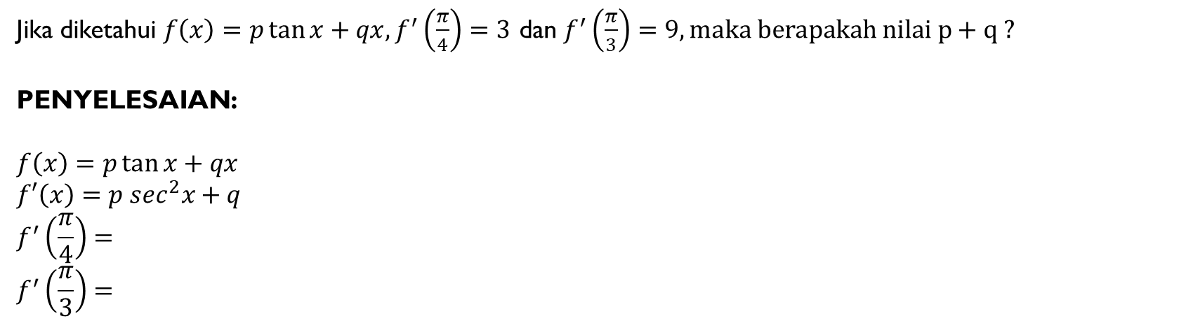



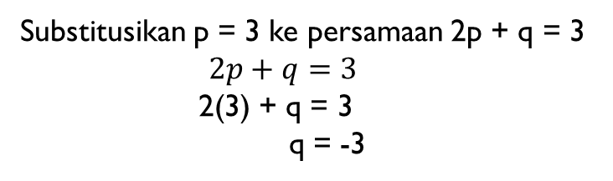
CONTOH NO. 4
Jika diketahui $f\left(x\right)=p\tan{x}+qx, f^{′}\left(\frac{π}{4}\right)=3$ dan $f^{′}\left(\frac{π}{3}\right)=9, maka berapakah nilai p+q ?$
PENYELESAIAN:
$$f\left(x\right)=p\tan{x}+qx$$
$f′\left(x\right)=p\sec^{2}x+q$
$$f^{′}\left(\frac{π}{4}\right)=$$
$$f^{′}\left(\frac{π}{3}\right)=$$
$$p\sec^{2}\left(\frac{π}{4}\right)+q=$$
Substitusikan p = 3 ke persamaan 2p + q = 3
$2p+q=3$
2(3) + q = 3
q = -3
$$2p+q=$$
$3$
$$p\sec^{2}\left(\frac{π}{3}\right)+q=$$
$$4p+q=$$
$$9$$
-2p = -6
p = 3
Maka, nilai dari : p + q = 3 + (-3) = 0

