Slide 1
Turunan fungsi trigonometri
By: siti syarah maulydia, m.pD

Slide 2
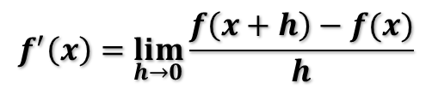
Memahami Konsep Turunan
Definisi
Turunan fungsi f terhadap x dinyatakan dengan f’(x) adalah
jika limit itu ada.
$$f^{′}\left(x\right)=\lim_{h→0}{\frac{f\left(x+h\right)−f(x)}{h}}$$

Slide 3
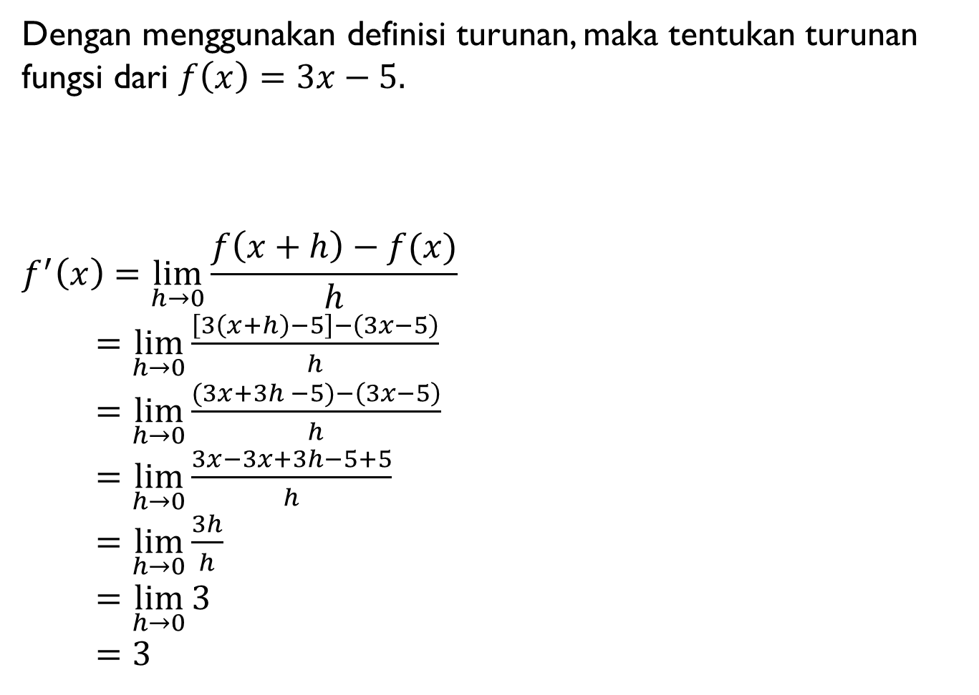
Dengan menggunakan definisi turunan, maka tentukan turunan fungsi dari $f\left(x\right)=3x−5.$
$$f^{′}\left(x\right)=\lim_{h→0}{\frac{f\left(x+h\right)−f(x)}{h}}$$
$=\lim_{h→0}{\frac{\left[3\left(x+h\right)−5\right]−\left(3x−5\right)}{h}}$
$=\lim_{h→0}{\frac{(3x+3h −5)−\left(3x−5\right)}{h}}$
$=\lim_{h→0}{\frac{3x−3x+3h−5+5}{h}}$
$=\lim_{h→0}{\frac{3h}{h}}$
$=\lim_{h→0}{3}$
$=3$
C
O
N
T
O
H
NO. 1
Penyelesaian :

Slide 4
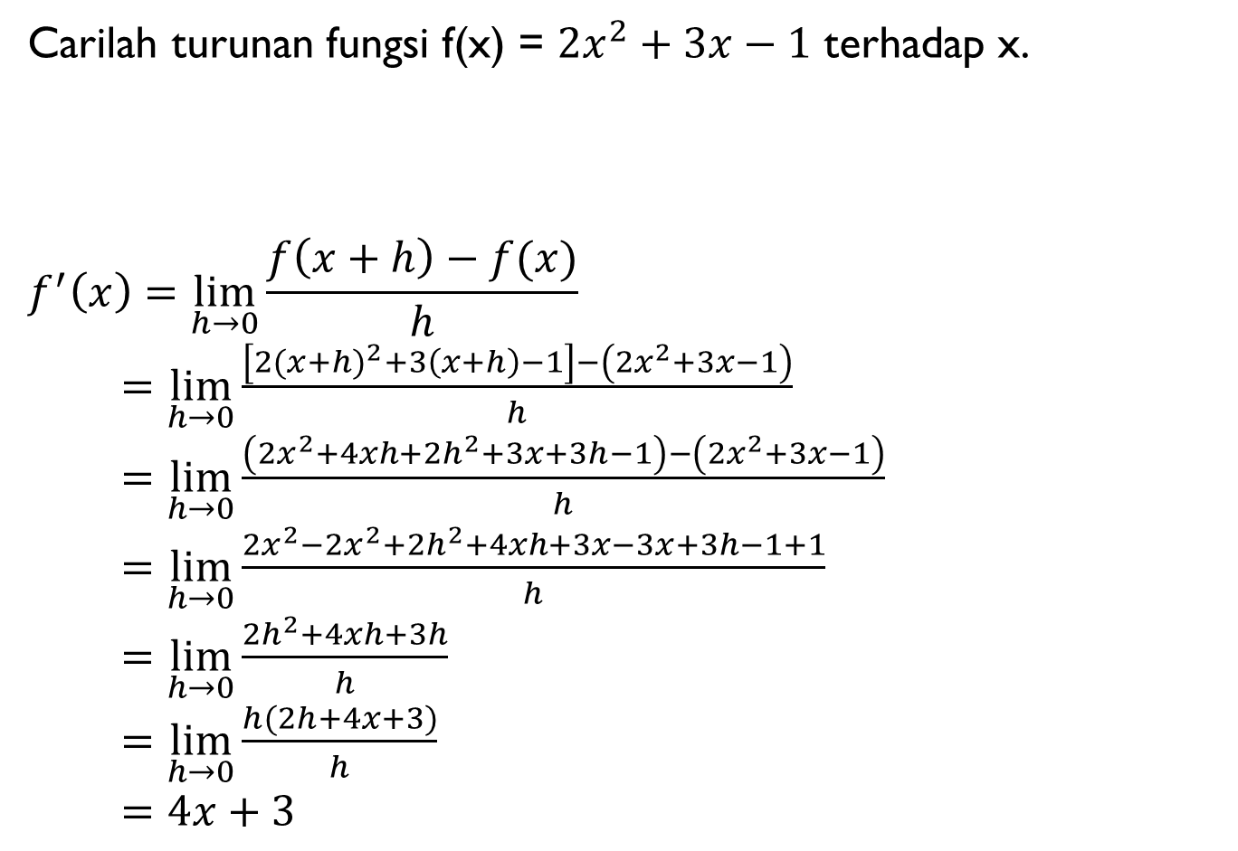
Carilah turunan fungsi f(x) = ${2x}^{2}+3x−1$ terhadap x.
$$f^{′}\left(x\right)=\lim_{h→0}{\frac{f\left(x+h\right)−f(x)}{h}}$$
$=\lim_{h→0}{\frac{\left[2{(x+h)}^{2}+3\left(x+h\right)−1\right]−\left({2x}^{2}+3x−1\right)}{h}}$
$=\lim_{h→0}{\frac{\left({2x}^{2}+4xh+{2h}^{2}+3x+3h−1\right)−\left({2x}^{2}+3x−1\right)}{h}}$
$=\lim_{h→0}{\frac{{2x}^{2}−{2x}^{2}+{2h}^{2}+4xh+3x−3x+3h−1+1}{h}}$
$=\lim_{h→0}{\frac{{2h}^{2}+4xh+3h}{h}}$
$=\lim_{h→0}{\frac{h(2h+4x+3)}{h}}$
$=4x+3$
C
O
N
T
O
H
NO. 2
Penyelesaian :

Slide 5
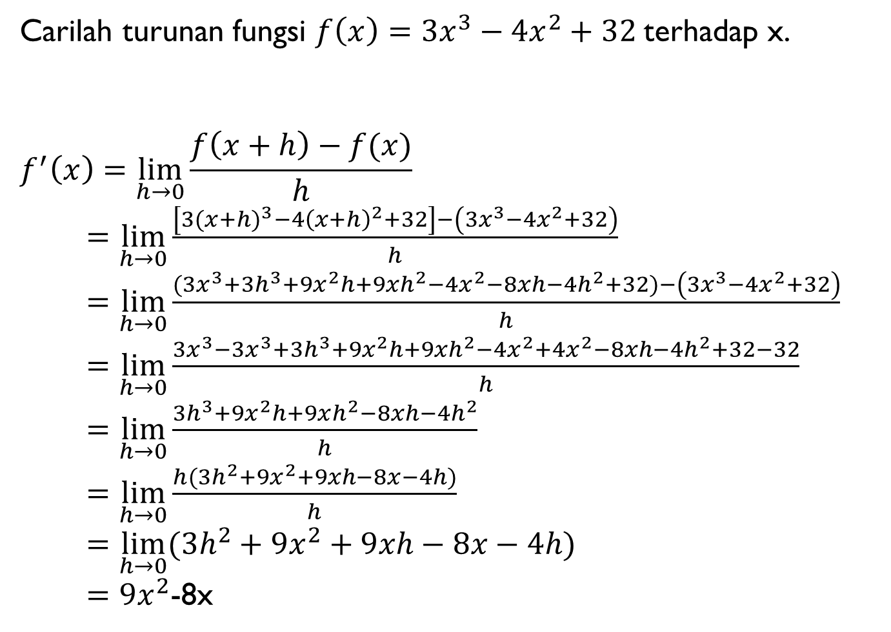
Carilah turunan fungsi $f\left(x\right)=3x^{3}−4x^{2}+32$terhadap x.
$$f^{′}\left(x\right)=\lim_{h→0}{\frac{f\left(x+h\right)−f(x)}{h}}$$
$=\lim_{h→0}{\frac{\left[3{(x+h)}^{3}−{4\left(x+h\right)}^{2}+32\right]−\left(3x^{3}−4x^{2}+32\right)}{h}}$
$=\lim_{h→0}{\frac{(3x^{3}+3h^{3}+9x^{2}h+9xh^{2}−4x^{2}−8xh−4h^{2}+32)−\left(3x^{3}−4x^{2}+32\right)}{h}}$
$=\lim_{h→0}{\frac{3x^{3}−3x^{3}+3h^{3}+9x^{2}h+9xh^{2}−4x^{2}+4x^{2}−8xh−4h^{2}+32−32}{h}}$
$=\lim_{h→0}{\frac{3h^{3}+9x^{2}h+9xh^{2}−8xh−4h^{2}}{h}}$
$=\lim_{h→0}{\frac{h(3h^{2}+9x^{2}+9xh−8x−4h)}{h}}$
$=\lim_{h→0}{(3h^{2}+9x^{2}+9xh−8x−4h)}$
$=9x^{2}$-8x
C
O
N
T
O
H
NO. 3
Penyelesaian :

