Slide 1
TRIGONOMETRI
E. RUMUS PENJUMLAHAN DAN PENGURANGAN TRIGONOMETRI
By:
Siti Syarah Maulydia, M.Pd

Slide 2
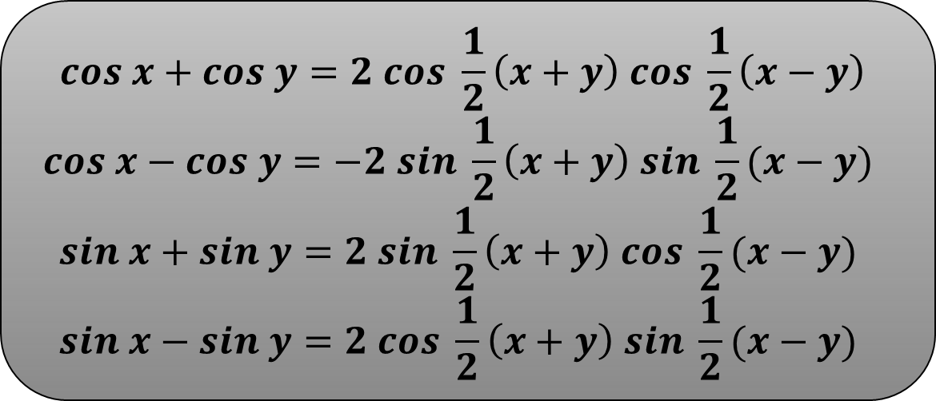
RUMUS PENJUMLAHAN DAN PENGURANGAN TRIGONOMETRI
RUMUS 1.11
$$cos x+cos y=2 cos \frac{1}{2}\left(x+y\right) cos \frac{1}{2}\left(x−y\right)$$
$$cos x−cos y=−2 sin \frac{1}{2}\left(x+y\right) sin \frac{1}{2}(x−y)$$
$$sin x+sin y=2 sin \frac{1}{2}\left(x+y\right) cos \frac{1}{2}(x−y)$$
$$sin x−sin y=2 cos \frac{1}{2}\left(x+y\right) sin \frac{1}{2}(x−y)$$

Slide 3
Contoh
Hal. 38 No 11 Bentuk cos 3x + cos x = ….
Jawab:
Cos 3x + cos x =
= 2 cos 2x cos x
= 2 cos x cos 2x
$=2 cos x (2\cos^{2}x−1)$
$$2\cos{\frac{1}{2}\left(3x+x\right)\cos{\frac{1}{2}(3x−x)}}$$
Hal 38 No 14
Diketahui sin x + cos x = 0,5 maka nilai sin 2x sama dengan …
Jawab :
$$sin x+cos x=0,5$$
$${ (sin x+cos x)}^{2}={(0,5)}^{2}$$
$$\sin^{2}x+\cos^{2}x+2 sin x cos x=0,25$$
$1 + sin 2x =0,25$
$$sin 2x =−0,75$$

Slide 4
Hal 38 No 13
Diketahui sin x = 0,6. Nilai sin 3x + sin x adalah …
Jawab:
$$sin 3x+sin x=$$
$=2 cos x sin 2x$
$=2 cos x \left(2 sin x cos x\right)$
$=2 ∙\frac{8}{10}\left(2∙\frac{6}{10}∙\frac{8}{10}\right)$
$=$ $2$
$=\frac{192}{125}$
$$2 sin 2x cos x$$
Cos x = $\sqrt{1−{\left(\frac{6}{10}\right)}^{2}}$
$$=\frac{8}{10}$$
$$∙\frac{4}{5}$$
$$∙\frac{3}{5}$$
$$∙\frac{4}{5}$$
$$\left(2 \right)$$

