Slide 1
Opinion and Thoughts

Slide 2
Is the way you feel or think about something. Opinion is including the words of opinion and argument/ reasons. Opinion dialogue is a dialog consists of two persons or more who have opinion each other’s
OPINION

Slide 3
Mecy : I like Harry Porter movies because the magic seems so real.
Rafly :I don’t agree with you. Harry Porter movies are just overrated.
Narti : I like playing tag because it is so much fun.
Rico :I don’t like playing tag because people end up fighting.
Renda : In my opinion, the government should provide means of sustenance for under privileged people instead of building tall towers.
Rido : I agree with what you are saying but have you ever thought that building tall tower provides work for unemployed people?

Slide 4
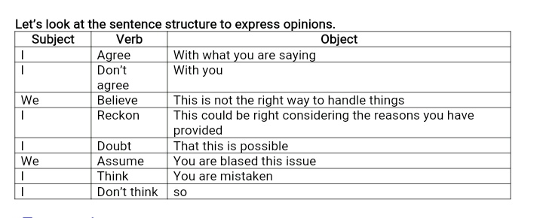

Slide 5
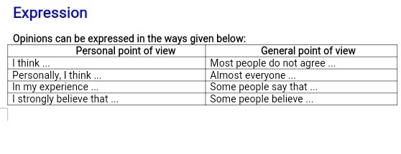
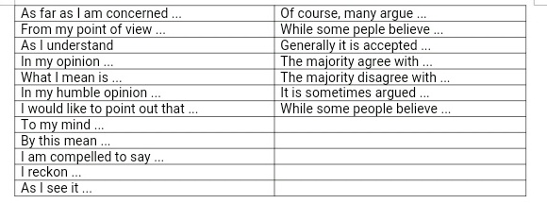

Slide 6
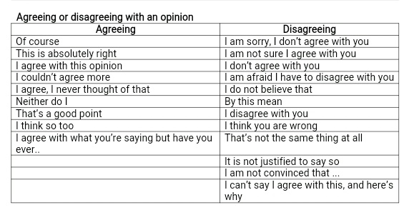

Slide 7
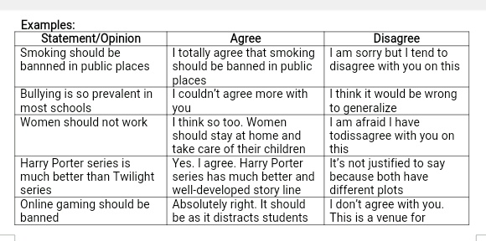

Slide 8
Conversation I
Ahmad : What do you think of English material? Siti : I think English is a difficult language that I have learned . Ahmad : What do you mean? Siti : English is different from Bahasa, it has many term to arrange anything and it makes me confused. Ahmad : I think you are wrong Siti, English is the easy one if you make it your habit in daily life. (disagreeing with an opinion)

Slide 9
CONVERSATION II
Salsabila : What is your opinion about global warming?
Johan : Some people say that it causes of the wrong way of life.
Salsabila : What do you mean?
Johan : Well, we have to start to do what we can do to help reduce global warming.
Salsabila : That’s a good point. Let’s do that by this time. (agreeing with opinion)

Slide 10
THANK YOU

