Slide 1




ANALYTICAL EXPOSITION TEXT (Review)

Slide 2
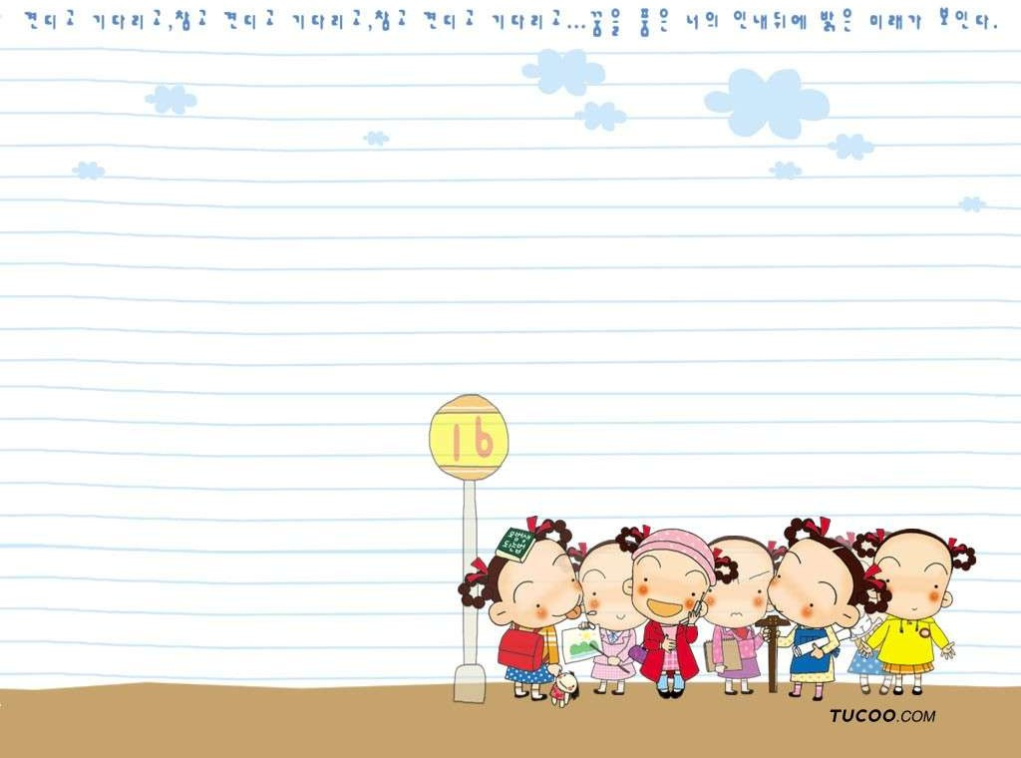
Definition of Analytical Exposition Text
Analytical Exposition text is a text that elaborates the writer’s idea about the phenomenon surrounding or Analytical Exposition text evaluates a topic critically but focuses only on one side of an argument.
Exposition text adalah teks yang menguraikan
pemikiran penulis tentang peristiwa disekitarnya.

Slide 3

The Social Function and the Examples of Analytical Exposition Text
It’s social function is to persuade the reader that the idea is important matter.
Tujuannya untuk meyakinkan pembaca bahwa pemikiran itu persoalan yang penting.
Examples of Exposition Texts are:
Legal Defenses, Speeches / Lectures, Editorials, Newspaper Articles, Essays, Political Leaflets, Letters.

Slide 4

Generic Structure of Analytical Exposition Text is :
Thesis
Position : Introduces topic and indicates writer’s position.
Preview : Outlines the main arguments to be presented.
Thesis
Position : Memperkenalkan pokok pembicaraan dan menunjukan kedudukan penulis.
Preview : Menguraikan uraian pokok pembicaraan yang akan disajikan.
Arguments
Point : Restates main
Arguments
arguments outlines in Preview. Elaboration : Develops and supports each argument.
Point : Menyatakan kembali
uraian pokok serta menguraikannya. Elaboration : Mengembangkan dan mendukung setiap pendapat.
Reiteration
A conclusion summing up the arguments.
Reiteration
Kesimpulan dari pendapat.

Slide 5

Significant Lexicogrammatical Features of Analytical Exposition Text is :
Focus on Generic human and non- human participants
Use of simple present tense
Use of Relational Processes (Linking Verbs)
Use of Connectives (words that links arguments)
Use of internal conjuction Use of causal conjuction

Slide 6

Generic human & non-human participant : yang diceritakan bersifat umum (bisa apa saja) yang penting bisa mempengaruhi pendengar.
Relational process (Linking verb) yaitu kata kerja penghubung .

Slide 7
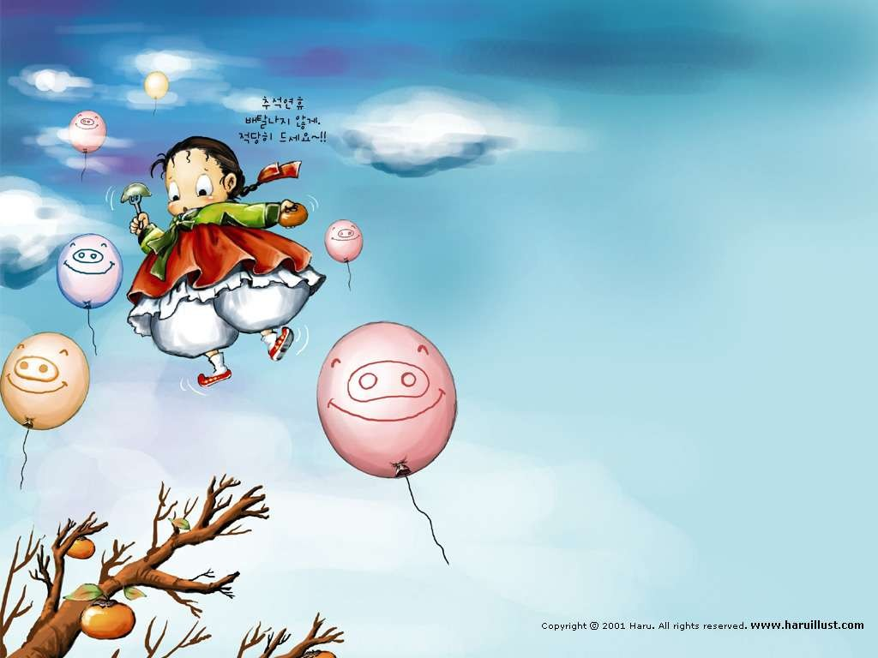
CONNECTIVES
Ordering and Evaluating | Firstly, secondly, after, then, finally, furthermore, ultimately, the most important …., another important …, most of all …
Contrast | Although, however, whereas, on the other hand, yet, unlike
Comparison | Also, in addition, as well as, neither, similarly
Explaining | Because, since, as, therefore, thus, hence, consequently, as the result, due to …

Slide 8
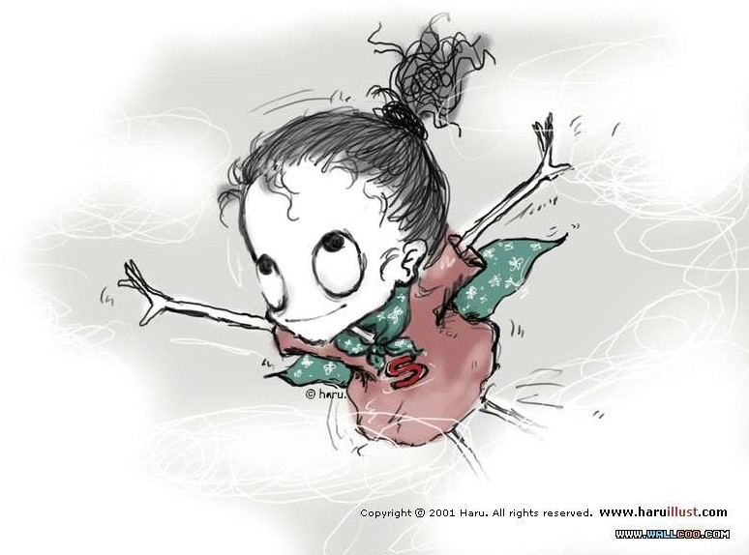
To make conclusion, we can use these expressions:
In conclusion, …..
From the facts above, ….
Therefore, …….
On this basis, …..
To conclude, …..
We state that ……..
On the whole, ….
We conclude that …
From the statement, …….

Slide 9
Example of Analytical Eposition
Generic
Integrated pest management
Non-human
participant
There is no one best way to deal with pest
agriculture. Pesticides are commonly used, but this may cause many problems. Combining different
management operations is the most effective way
Connectives
to control pest.
Firstly, the chemical in pesticides may build up as residues in the environment. This reduces the
quality of farm produce.
Simple
As well, pest can gradually become resistant
Present Tense
to pesticides. This means that newer and
sometimes stronger one have to be developed.
Some pesticides affect non target animals
such as fish and bees. This affects the natural
balance.
Also aiming to completely wipe out agricultural pests may be very expensive. Sometimes pest damage costs less than the method of control.
Lastly, understanding the ecology of the area helps a lot in pest control. Natural enemies can be
Causal
used to control a pest. Pesticides should be chosen
Conjunction
that don’t affect the natural enemies.
Therefore, integrated pest management is a
safe and more affective option in agriculture.

Slide 10

Generic Structure
Title |  |  | Integrated pest management
thesis |  | Position preview | There is no one best way to deal with pest agriculture. Pesticides are commonly used, but this may cause many problems. Combining different management operations is the most effective way to control pest.
argument | 1 | Point elaboration | Firstly, the chemical in pesticides may build up as residues in the environment. This reduces the quality of farm produce.
argument | 2 | Point elaboration | As well, pest can gradually become resistant to pesticides. This means that newer and sometimes stronger one have to be developed.
argument | 3 | Point elaboration | Some pesticides affect non target animals such as fish and bees. This affects the natural balance.
argument | 4 | Point elaboration | Also aiming to completely wipe out agricultural pests may be very expensive. Sometimes pest damage costs less than the method of control.
argument | 5 | Point elaboration | Lastly, understanding the ecology of the area helps a lot in pest control. Natural enemies can be used to control a pest. Pesticides should be chosen that don’t affect the natural enemies.
reiteration / conclusion |  |  | Therefore, integrated pest management is a safe and more affective option in agriculture.

Slide 11
Any questions??

