Slide 1
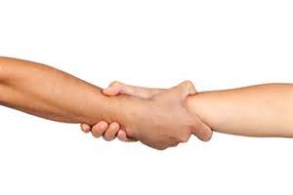
OFFERING FOR HELP
BY LIYAMNAH MUNTE

Slide 2
INTRODUCTION
When something need to be done you can ask someone else to do it, or offer to do it yourself or just do it without saying anything.
If someone else is doing something, you can offer to help.
.

Slide 3
Some Useful Ways of Offering to Help
Let me get it for you
Can I help you with that?
Could/Can I…?
How about I…?
May I…?
If you like, I can get it for you
Would you like me to...?
Shall I get it for you?
Do you need a hand?

Slide 4
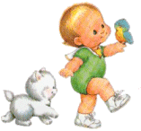
ACCEPTING an OFFER
That’s very kind of you, thanks
Oh, would you? Thanks.
Thank you/ Thanks a lot
If you don’t mind
Yes, please
That would be nice/ so kind of you
That’s so sweet/nice/kind of you

Slide 5
Answer to Refuse/Declining an Offer
No, thanks.
No, I really won’t, thank you.
Not for me thanks.
No, thanks. I’m not hungry.
No, don’t bother, I can do it by myself
No, it’s alright, I can manage
I can handle it
That’s very kind. Unfortunately, I’d like to, but....

Slide 6
Accepting an Offer
Would you like me to help you with this?
Thank you. That would be great
Mr. Hans
Bob

Slide 7
Refussing an Offer
Are you looking for something? Do you need my help?
No, I really won’t, thank you.
Mr. Hans
Bob

Slide 8
Exercise One
Loli : Hay la, why you look so busy ? Paula : I prepare for my sister’s birthday, I just want to make it amazing party.
Loli : ……… ……... …….to make amazing party, you just need some money and I will help you to choose the best gift. Paula :…….. ………... ……… ………… . Loli : Okay, do your best. Fighting!!!! Paula : Thanks Li
What can I do for you?
Thanks. but I can handle it
Let me help you

Slide 9
Exercise Two
Okay thanks for your kindness
Can I help you?
Can you help me?
Ani : Hey ! What are you going to do?
Nia : I will going to water my flower! Nevertheless, I must take my mother to see the doctor. She got headache.
Ani : _____________ to water your flower? . I will glad if I can help you.
Nia : ________________________. You can take the water over there.
Ani : I will do it.
Nia : thank you very much.

Slide 10
Expression in:
Offering or Giving Help:
Receiving Help:
Yes please
Ok, thank you/ Thanks a lot
Ok, thanks for your kindness
If you don’t mind
That would be so knd of you
Let me get t for you
Shall I get it for you?
Could/ can I
Do you need a hand?
How about i…?
Would you like me to help…?
If you like, I can get it for you
Can I help you with that?
Thanks, But I can do it my self
Thanks, I can handle it
3. Thanks, don’t better your self
4. there’s no need, thanks
Rejecting/refusing:

