Slide 1
Modals to Express Obligation: SHOULD, OUGHT TO
BY LIYAMNAH MUNTE

Slide 3
Should/Ought to – Obligation
When we want to talk about obligation we are talking about the right thing to do:
Examples You should/ought to finish your homework before you watch TV. You shouldn’t/ought not to leave lights on when you leave the
room.
Should/ought to are also used to say what is the best thing to do or to give recommendations:
You should/ought to walk to work. The weather in Malta is perfect. You should/ought to come over
for a holiday.

Slide 5
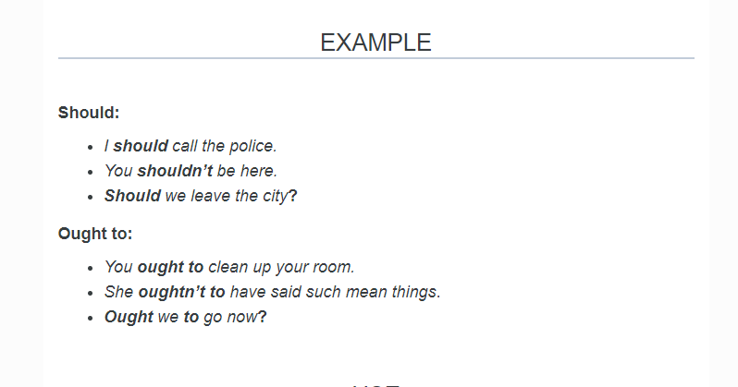

Slide 6
USE
Both of these modal verbs have a very similar meaning and one can replace the other. They can be considered not to be as strong as must.
However, should is used much more often and it is less formal than ought to. Ought to is almost never used in interrogative and negative form.

Slide 7
EXAMPLES
You should tell the truth. OR You ought to tell the truth.
He should be punctual. OR He ought to be punctual.
He should stop smoking. OR He ought to stop smoking.
She should find a better job. OR She ought to find a better job.
He should consult a doctor. OR He ought to consult a doctor.

