Slide 1
LIMIT
FUNGSI TRIGONOMETRI
(PEMBAHASAN SOAL)
Lanjutan …
By:
SITI SYARAH MAULYDIA, M.Pd

Slide 2
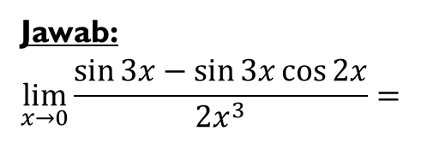
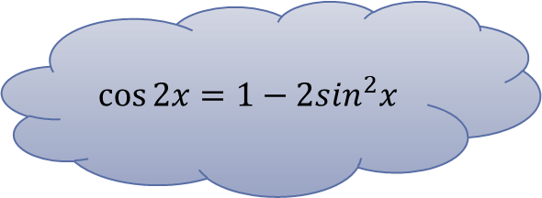
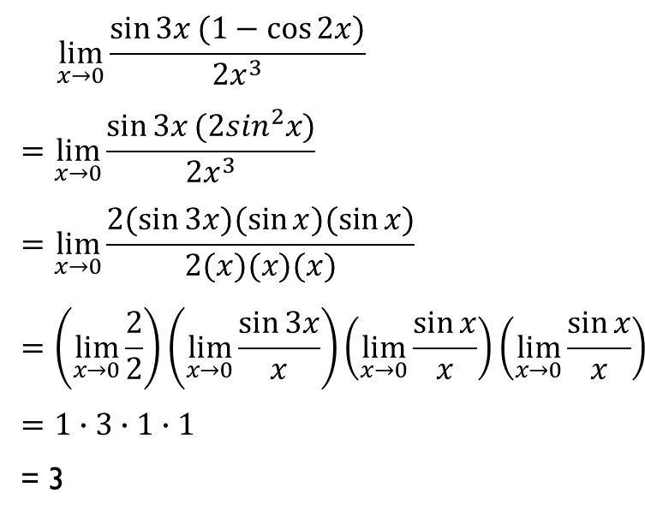
Contoh 1
Tentukan nilai dari $\lim_{x→0}{\frac{\sin{3x}−\sin{3x}\cos{2x}}{2x^{3}}}$
Jawab:
$$\lim_{x→0}{\frac{\sin{3x}−\sin{3x}\cos{2x}}{2x^{3}}}=$$
$$\cos{2x}=1−2\sin^{2}x$$
$$\lim_{x→0}{\frac{\sin{3x}(1−\cos{2x)}}{2x^{3}}}$$
$$=\lim_{x→0}{\frac{\sin{3x}(2\sin^{2}x)}{2x^{3}}}$$
$$=\lim_{x→0}{\frac{2(sin{3x})(\sin{x})(\sin{x)}}{2(x)(x)(x)}}$$
$$=\left(\lim_{x→0}{\frac{2}{2}}\right)\left(\lim_{x→0}{\frac{\sin{3x}}{x}}\right)\left(\lim_{x→0}{\frac{\sin{x}}{x}}\right)\left(\lim_{x→0}{\frac{\sin{x}}{x}}\right)$$
$$=1∙3∙1∙1$$
= 3

Slide 3
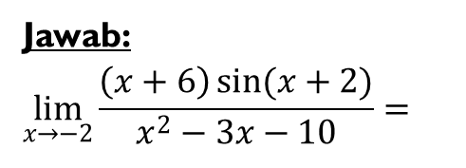
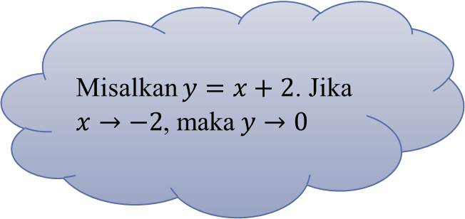
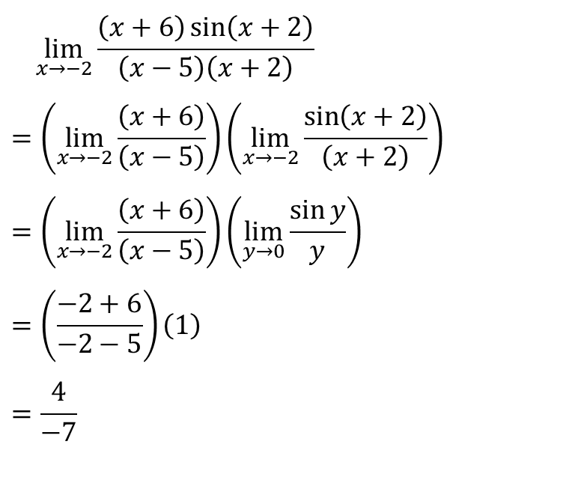
Contoh 2
Tentukan nilai dari$\lim_{x→−2}{\frac{\left(x+6\right)\sin{(x+2)}}{x^{2}−3x−10}}$
Jawab:
$$\lim_{x→−2}{\frac{\left(x+6\right)\sin{(x+2)}}{x^{2}−3x−10}}=$$
$$\lim_{x→−2}{\frac{\left(x+6\right)\sin\left(x+2\right)}{\left(x−5\right)\left(x+2\right)}}$$
$$=\left(\lim_{x→−2}{\frac{\left(x+6\right)}{\left(x−5\right)}}\right)\left(\lim_{x→−2}{\frac{\sin\left(x+2\right)}{\left(x+2\right)}}\right)$$
$$=\left(\lim_{x→−2}{\frac{\left(x+6\right)}{\left(x−5\right)}}\right)\left(\lim_{y→0}{\frac{\sin{y}}{y}}\right)$$
$$=\left(\frac{−2+6}{−2−5}\right)\left(1\right)$$
$$=\frac{4}{−7}$$
Misalkan $y=x+2$. Jika $x→−2$, maka $y→0$

Slide 4
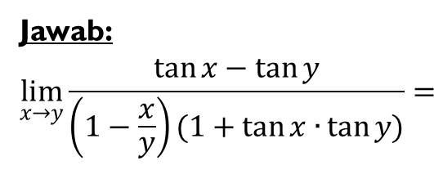
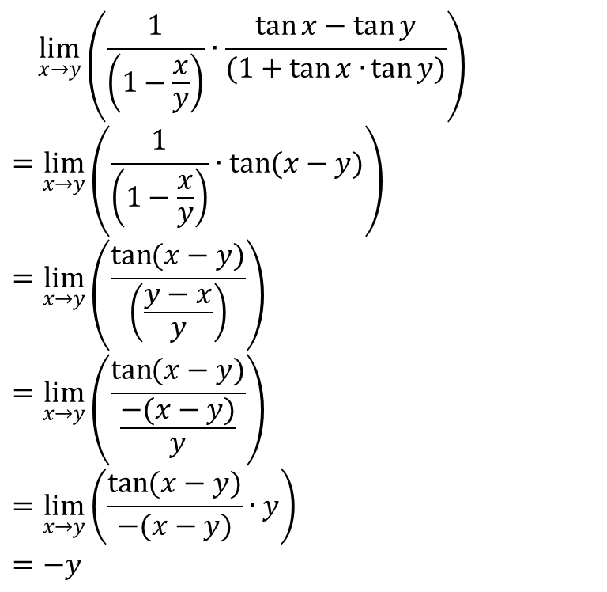
Contoh 3
Tentukan nilai dari $\lim_{x→y}{\frac{\tan{x}−\tan{y}}{\left(1− \frac{x}{y}\right)(1+\tan{x∙}\tan{y)}}}$
Jawab:
$$\lim_{x→y}{\frac{\tan{x}−\tan{y}}{\left(1−\frac{x}{y}\right)(1+\tan{x∙}\tan{y)}}=}$$
$$\lim_{x→y}\left(\frac{1}{\left(1−\frac{x}{y}\right)}∙\frac{\tan{x}−\tan{y}}{(1+\tan{x∙}\tan{y)}}\right)$$
$$=\lim_{x→y}\left(\frac{1}{\left(1−\frac{x}{y}\right)}∙\tan{(x−y)}\right)$$
$$=\lim_{x→y}\left(\frac{\tan{(x−y)}}{\left(\frac{y−x}{y}\right)}\right)$$
$$=\lim_{x→y}\left(\frac{\tan{(x−y)}}{\frac{−(x−y)}{y}}\right)$$
$$=\lim_{x→y}\left(\frac{\tan{(x−y)}}{−(x−y)}∙y\right)$$
$$=−y$$

