Slide 1
LIMIT
FUNGSI TRIGONOMETRI
By:
SITI SYARAH MAULYDIA, M.Pd

Slide 2
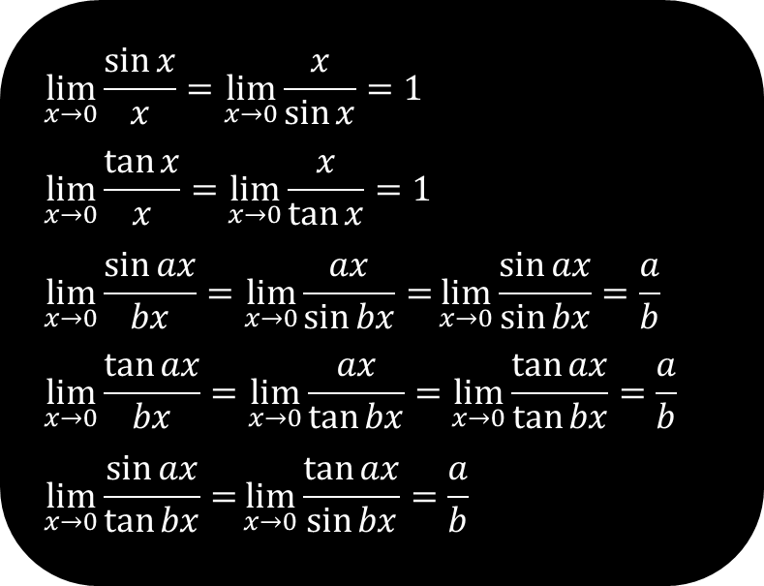
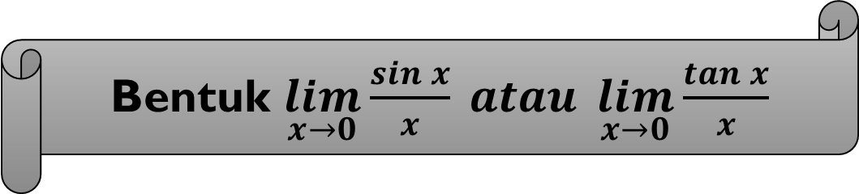
Bentuk $\lim_{x→0}{\frac{\sin{x}}{x}} atau \lim_{x→0}{\frac{\tan{x}}{x}}$
$$\lim_{x→0}{\frac{\sin{x}}{x}}=\lim_{x→0}{\frac{x}{\sin{x}}=1}$$
$$\lim_{x→0}{\frac{\tan{x}}{x}}=\lim_{x→0}{\frac{x}{\tan{x}}=1}$$
$$\lim_{x→0}{\frac{\sin{ax}}{bx}}=\lim_{x→0}{\frac{ax}{\sin{bx}}=}\lim_{x→0}{\frac{\sin{ax}}{\sin{bx}}=\frac{a}{b}}$$
$$\lim_{x→0}{\frac{\tan{ax}}{bx}}=\lim_{x→0}{\frac{ax}{\tan{bx}}=\lim_{x→0}{\frac{\tan{ax}}{\tan{bx}}=\frac{a}{b}}}$$
$$\lim_{x→0}{\frac{\sin{ax}}{\tan{bx}}=}\lim_{x→0}{\frac{\tan{ax}}{\sin{bx}}=\frac{a}{b}}$$

Slide 3

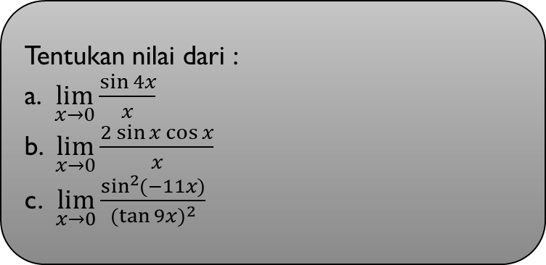



Contoh
Tentukan nilai dari :
a. $\lim_{x→0}{\frac{\sin{4x}}{x}}$
b. $\lim_{x→0}{\frac{2 sin{x\cos{x}}}{x}}$
c. $\lim_{x→0}{\frac{\sin^{2}{(−11x)}}{(\tan{9{x)}^{2}}}}$
Jawab :
$$\frac{4}{1}$$
$\lim_{x→0}{\frac{\sin{4x}}{x}}=$
$\lim_{x→0}{\frac{2 sin{x\cos{x}}}{x}}=$
=4
$$\lim_{x→0}{\frac{\sin{2x}}{x}}=$$
$$\frac{2}{1}$$
=2

Slide 4
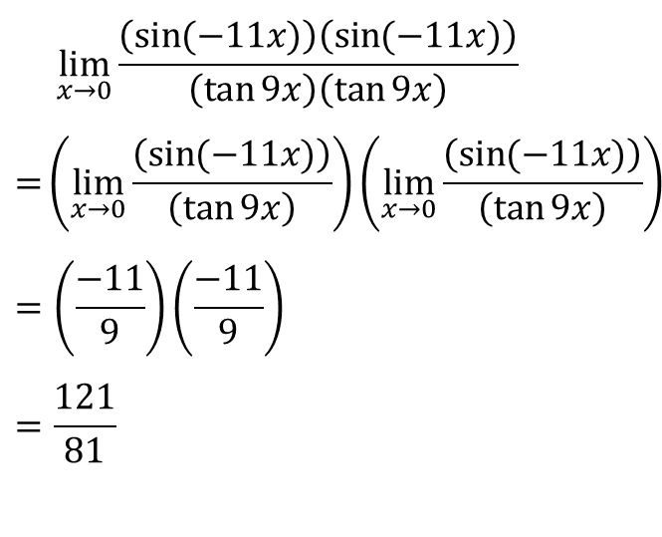
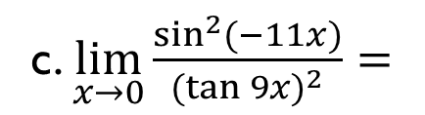
c. $\lim_{x→0}{\frac{\sin^{2}{(−11x)}}{(tan{9{x)}^{2}}}=}$
$$\lim_{x→0}{\frac{\left(\sin{(−11x)}\right)\left(\sin{(−11x)}\right)}{\left(\tan{9x}\right)\left(\tan{9x}\right)}}$$
$$=\left(\lim_{x→0}\frac{\left(\sin{(−11x)}\right)}{\left(\tan{9x}\right)}\right)\left(\lim_{x→0}\frac{\left(\sin{(−11x)}\right)}{\left(\tan{9x}\right)}\right)$$
$$=\left(\frac{−11}{9}\right)\left(\frac{−11}{9}\right)$$
$$=\frac{121}{81}$$

