Slide 1
LIMIT
FUNGSI TRIGONOMETRI
By:
SITI SYARAH MAULYDIA, M.Pd

Slide 2
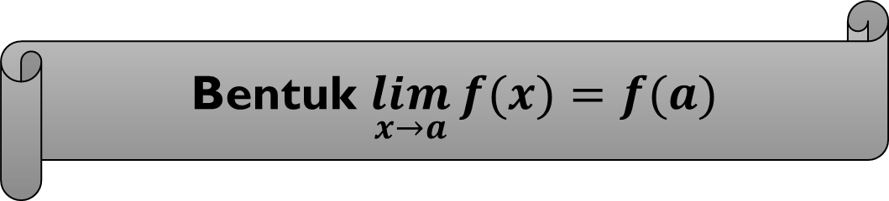
Bentuk $\lim_{x→a}{f(x)}=f(a)$
Substitusikan langsung nilai x = a pada fungsi f(x)

Slide 3


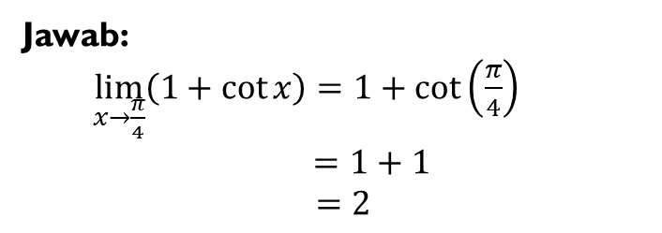

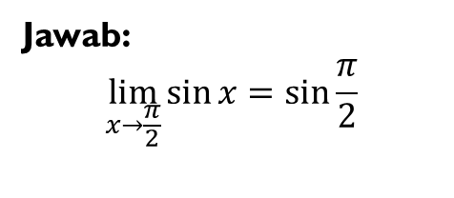
Contoh
Tentukan nilai dari :
$$\lim_{x→\frac{π}{2}}{\sin{x}}=…$$
Jawab:
$$\lim_{x→\frac{π}{2}}{\sin{x}}=\sin{\frac{π}{2}}$$
$$=1$$
$$\lim_{x→\frac{π}{4}}\left(1+\cot{x}\right)=…$$
Jawab:
$\lim_{x→\frac{π}{4}}\left(1+\cot{x}\right)=1+\cot\left(\frac{π}{4}\right)$
$=1+1$
$=2$

Slide 4
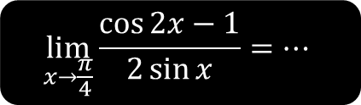

Tentukan nilai dari :
$$\lim_{x→\frac{π}{4}}{\frac{\cos{2x}−1}{2\sin{x}}=…}$$
Jawab :
$\lim_{x→\frac{π}{4}}{\frac{\cos{2x}−1}{2\sin{x}}=}\frac{\cos{2\left(\frac{π}{4}\right)}−1}{2\sin\left(\frac{π}{4}\right)}$
$=\frac{\cos\left(\frac{π}{2}\right)−1}{2\sin\left(\frac{π}{4}\right)}$
$=\frac{0−1}{2\left(\frac{1}{2}\sqrt{2}\right)}$
$=−\frac{1}{\sqrt{2}}$
$=−\frac{1}{\sqrt{2}}×\frac{\sqrt{2}}{\sqrt{2}}$
=$−\frac{1}{2}\sqrt{2}$

