Slide 1
CHAPTER 5 LETTER WRITING
BY: MISS ANNA SIPAYUNG

Slide 2
Types of Letters
Formal letter
Informal letter also known as personal letter

Slide 3
Personal Letters
Social Function
Personal letters are letters that are written to people we know such as friends, parents, siblings and cousins.
Letters are not only written to inform but to strengthen the bond between two people writing to each other.

Slide 4
Linguistic Features
Sentence structure
Accuracy of grammar is important
Complete sentences are expected.
Slang can be used.
Use the contractions such as I’ll , I’m , we’ll
Use the personal pronouns such as I , we, you
Use active voice

Slide 5
Style
Language use may be personal letter like first and second person pronouns.
Be warm.
Use the person’s name you are writing to.
Vary sentence length.
Write a natural, conversational style.
Let your personality shine through in your writing.

Slide 6
Structure of Personal Letter
Date
Date when the letter is written ( top left ).
Address
Place where you are writing from ( top right ).
Salutation & Name
Greeting and the person’s name you are writing to.

Slide 7
Introduction
The opening of the letter usually starts with how are you or refers to previous letter.
Body
The main part of the letter. It includes what you want to write to the other person.
Closure
The part indicates the is going to end.

Slide 8
Complimentary close
Short expressions like “love you”
“sincerely yours” “ love”
Signature
Signature or initials of the writer.
Postscript P.S.
After thought in a letter. You begin with P.S. and end it with your initials.

Slide 9
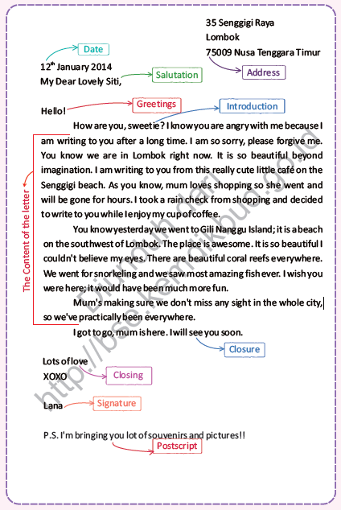
Example of a personal letter
-------O-------

Slide 10
Examples of expressions used in personal letters
Salutations
Dear, Dearest, Sweetheart, Darling, My dear, My love, ect.
Salutations depend on how well you know the person you are writing to.
Closing
Yours, With love, Sincerely yours, All the love, All the best, Affectionately, Much how, best wishes.

Slide 11
Starting the letter
How are you?
Hope this letter finds you …
Thank you for your last letter.
It was so good to hear from you.
Sorry for answering late.
I’m sorry I should have written earlier…
Haven’t heard from you in a while so I thought…
I am sorry to inform you that…

Slide 12
Conclusion
I am looking forward to seeing you soon.
I am looking forward to hearing from you soon.
My best wishes for the coming test.
See you.
I wil write soon.
I will have to stop now.
I am writing for a quick reply.
Looking forward to seeing you again.
Bye.

Slide 13
Example of personal letters

Slide 14
------OO-----

