Slide 1
FILLING OUT A FORM
BY LIYAMNAH MUNTE

Slide 2
DEFINITIONS OF FORM
A form is a document (printed or electronic) with spaces in which we can write or enter data.
A form is a document with spaces (also named fields or placeholders) in which to write or select, for a series of documents with similar contents.

Slide 3
KINDS OF FORM
There are many kinds of forms serving different function such as :
Purchase form to purchase some goods
Purchase form is also known as purchase order (PO) form. Purchase form is a commercial document which is made by a buyer to a seller and used as a request to purchase products or services. This form contains The company name, client's information, types, quantities, and agreed prices of products or service purchased.

Slide 4
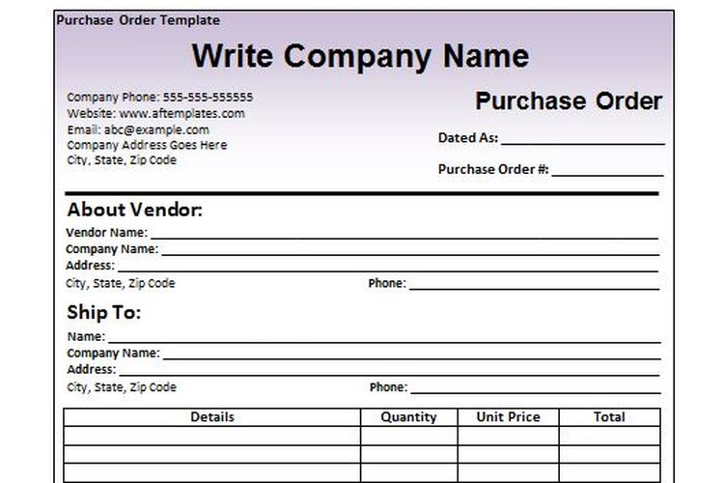
Purchase Form

Slide 5
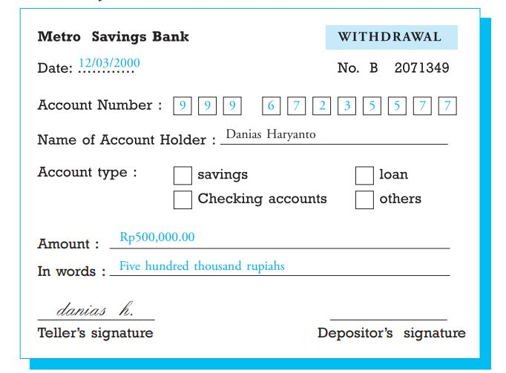
KINDS OF FORM
2. Withdrawal Slip to withdraw some money from the bank account

Slide 6
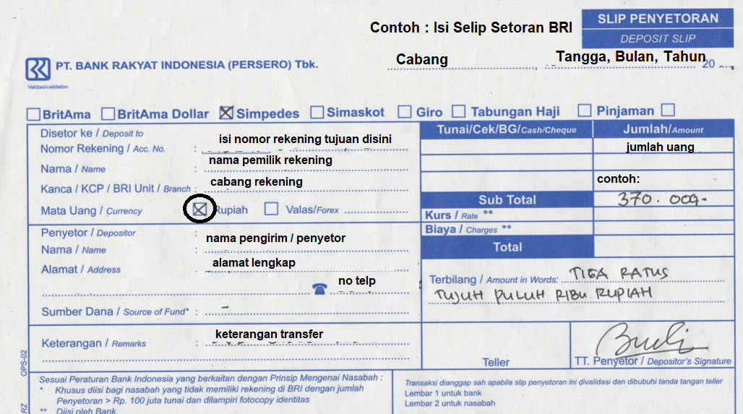
KINDS OF FORM
3. Deposit Slip to save some money to a bank account

Slide 7
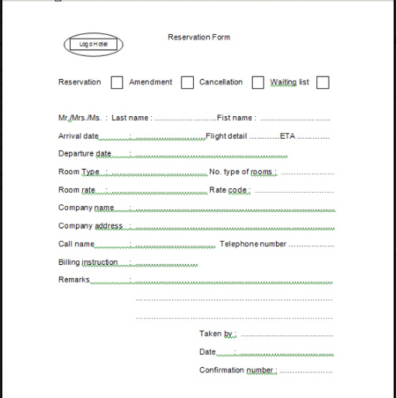
KINDS OF FORM
4. Reservation form to reserve or to book a place

Slide 8
KINDS OF FORM
5. Enrollment form to make someone become an official member of a course, collage, or group.

Slide 9
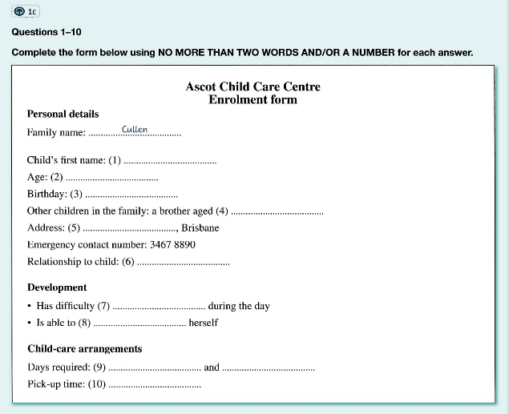
Enrollment Form

Slide 10
KINDS OF FORM
6. Medical form to keep patient’s data and information

Slide 11
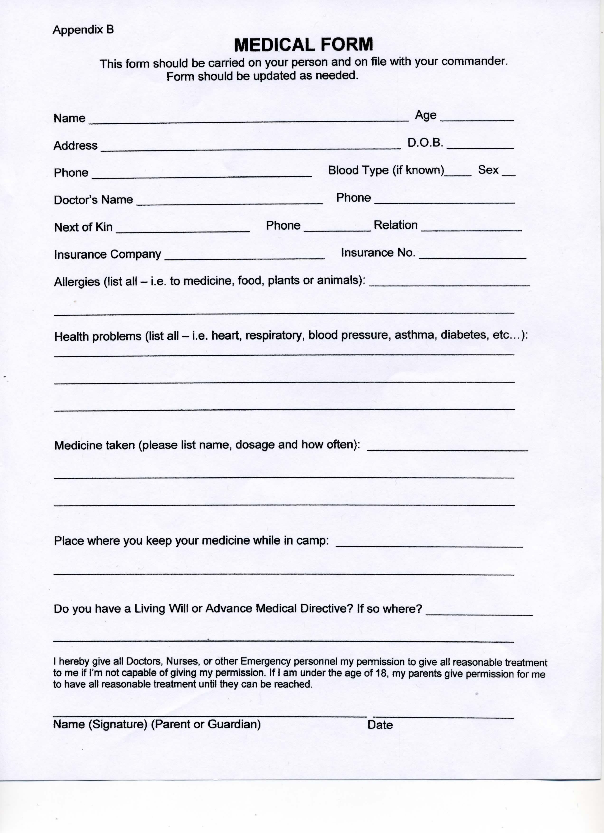

Slide 12
ELEMENTS OF FORM
A. The elements of a deposit form are:
Date
Account number
Name of account holder
Account type
Amount of money
Depositor's signature
Teller's signature

Slide 13
ELEMENTS OF FORM
B. The elements of the registrations form are:
Full name of the participants
Place and date of birth
Address
Phone Number
School / grade

Slide 14
CHARACTERISTICS OF THE FORM
Less to write. People only write what is instructed in the space
Clear instructions about information to be supplied
Uniformity. For a special purpose, each person will fill in a similar form
Information can be reexamined later to evaluate the accuracy of the information provided
Forms enable people to collect and distribute data easily.

Slide 15
THANK YOU
SEE YOU NEXT TIME

