Slide 1
FILLING OUT THE FORM
BY LIYAMNAH MUNTE

Slide 3
KINDS OF FORM
APPLICATION FORM
REGISTRASION FORM/ENROLMENT FORM
WITHDRAWAL SLIP
DEPOSIT SLIP
PURCHASE FORM
MEDICAL FORM
RESERVATION FORM

Slide 9
CHARACTERISTICS OF THE FORM
Less to write. People only write what is instructed in the space
Clear instructions about information to be supplied
Uniformity. For a special purpose, each person will fill in a similar form
Information can be reexamined later to evaluate the accuracy of the information provided
Forms enable people to collect and distribute data easily.

Slide 11
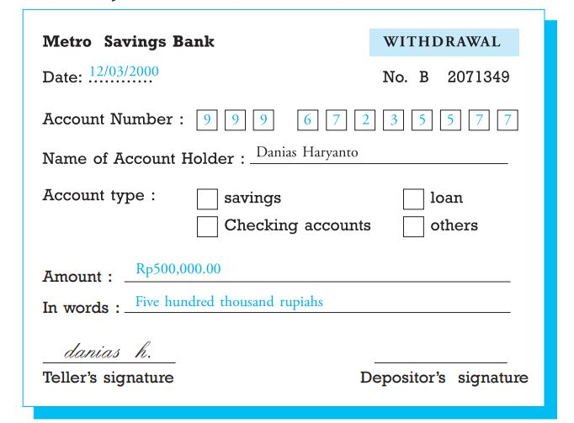

Slide 12
