Slide 1
Expressing Surprised Disbeliave
By LIYAMNAH MUNTE

Slide 2
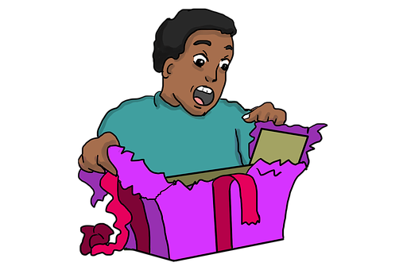
What do you think she/ he say?

Slide 3
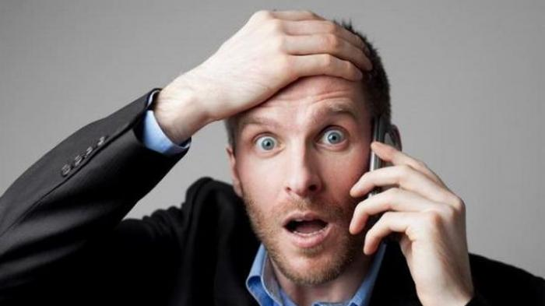
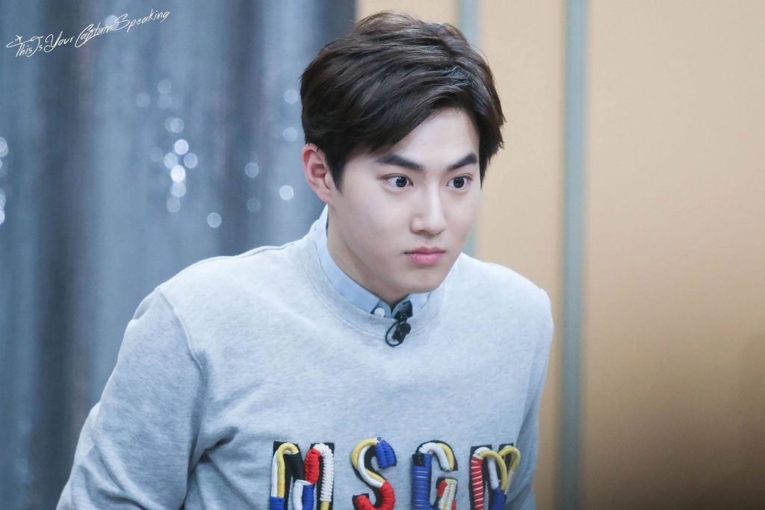
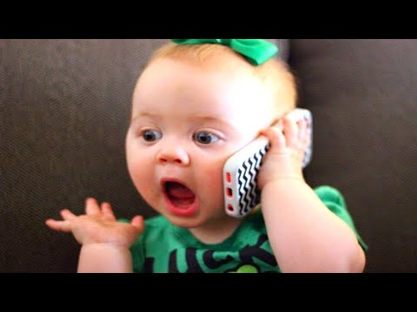

Slide 4
WHAT IS EXPESSING SURPRISE…?
EXPRESSING SURPRISE IS AN EXPRESSION OF SOMEONE WHEN GETTING A SURPRISE
FOR EXAMPLE WHEN SOMEONE GOT A PRESENT,SAW OR HEARD GOOD OR BAD NEWS,

Slide 5
is? Telling Surprising News
Believe it or not?
You may not believe it, but…..
Can you believe this?
Guess what! Coba tebak
Surprise! Kejutan
I’ve got news, for you. Aku punya berita untukmu
Do you know what? Kamu tahu apa?
You won’t believe it! Kamu tidak akan percaya itu!

Slide 6
SOME EXPRESSIONS OF SURPRISE
What a surprise! (Betapa mengejutkan!)
Oh! Wow! (Oh! Wow!).
Great. (Hebat).
Incredible. (Luar Biasa).
I am amazed at… (Saya kagum pada …).
That’s unbelievable! (Tidak dapat dipercaya!).
This really a big surprise (Ini benar-benar sebuah kejutan besar).
That was very surprising! (Itu sangat mengejutkan!).

Slide 7
SOME EXPRESSIONS OF SURPRISE
Is it true? (Apakah itu benar?).
My goodness! (Astaga).
Are you serious? (Apakah Anda serius?).
You must be joking (Anda pasti bercanda).
It was beyond belief (Itu melampaui keyakinan).
You make me shock! (Kamu membuatku terkejut).

Slide 8
Responding
Expressing surprise | Responding
Wow! What a surprise! | Yeah!
That’s a surprise! | It is
That’s very surprising! | Yup!
Really? | Positively!
What? | It’s true
Are you serious? You must be joking | I’m serious
You’re kidding! | No, I’m not
Fancy that! | It is
I must say it surprises me | Does it?
Here are some expressions of surprise

Slide 9
Asking Expressing of Disbelief
Asking if you believe it or not.
Do you believe it? Kamu percaya itu?
Wouldn’t you believe it? Kamu tidak akan percaya itu?
Can you imagine that? Bisakah kamu membayangkan itu?
You don’t believe it, do you? Kamu tidak percaya itu, kan?
Don’t you think it’s odd that….? Jangan kamu piker itu aneh….?

Slide 10
Expressing of Disbelief
Asking if you believe it or not.
I don’t believe it. Aku tidak percaya itu
It can’t be true. Itu tidak bisa dibenarkan.
I can’t think of it. Aku tidak bisa memikirkan itu.
I don’t trust you. Aku tidak mempercayaimu.

Slide 11
Responding to Believe or Not.
No, I don’t believe it. Tidak, aku tidak percaya ini
Are you serious? Apa kamu serius?
Are you joking? Apa kamu bercanda?
Are you kidding? Apa kamu bercanda?
You must be joking/kidding! Kamu pasti bercanda!
Oh, no! that’s not true! Oh, tidak! Itu tidak benar!
You don’t say! Kamu tidak boleh mengatakannya!
Seeing is believing. Melihat berarti mempercayai
Really? That sounds interesting. Benarkah? Kedengaran menarik.
Really? It’s surprising that. Benarkah? Itu mengejutkannya.
Good heavens. surga bagus
My goodness! kebaikanku
This is really a surprise! Ini benar-benar sebuah kejutan

Slide 12
Contoh 1 (In the school)
A : Dinda, do you know something?
B : About what?
A : About your score
B : About my examination score?
A : Yes, I hear that you get 100 in mathematic
B : I don’t believe it , are you serious?
A : Yes, of course
B : I don’t believe it, mathematic is difficult major for me .
A : But the fact you got it ,Congratulation!
B : Okay thank you but I never believe that .

Slide 13
Nely : Hi, Diny. Where is Johan now? I have not seen him for three days. Diny : Have you known that Johan is sick? He got fever. He has been hospitalized. Nely : Are you sure? You must be kidding me. I called him yesterday. Diny : Yes I was in the hospital when you called him yesterday Nely : Oh, Really? I never realize it.
What happens with Johan?
Johan treated in hospital because he got fever
Johan is staying at home
Nely was sick, she has been hospitalized
Diny got fever, she has been hospitalized
Johan called Nely because he got sick

Slide 14
Jack : Whose motorbike is that? Dany : It is David’s. Jack : _________________. Dany : No, I’m not. I saw him riding that motorbike this morning. Jack : What a surprise! 3. The suitable expression to complete the dialogue is … A. It’s true. B. I’m serious. C. Are you kidding me? D. Do you know about that? E. I'm really glad to know

