Slide 1
Descriptive Text (II)
By: Miss Anna Sipayung, S.Pd, M.S.

Slide 2
What is Descriptive text?
Descriptive text is a kind of text with a
purpose context
to give information. The of this kind of text is
description of particular thing, animal, person, or others.

Slide 3
The Generic Structure of Descriptive Text
Identification
Introducing where or who is the subject is being describe.
Description
Describes parts, qualities, and the characteristic of the person, place, or thing to be describe.

Slide 4
Grammatical feature
Focus on Specific Participant
Adjective
The Use of simple present tense

Slide 5
Describing person!
Has … children/ ….Daughter(s) and … son(s)
Likes …+ ing
Doesn’t like …+ing
What does he/she look like?
He/she …
Is tall/short
Is fat/ skinny
Has long/short hair
Has black/brown/red/blond/gray hair Has brown/blue/green eyes.
His/her name is …
He/she…
Is …years old
Is …(nationality)
Speaks … (language)
Is from….
Lives in ….
Is single/married

Slide 6
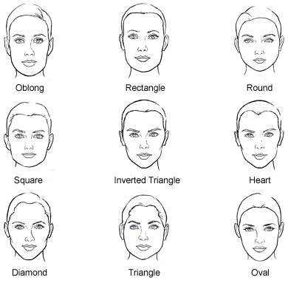
THE KINDS OF FACE

Slide 7
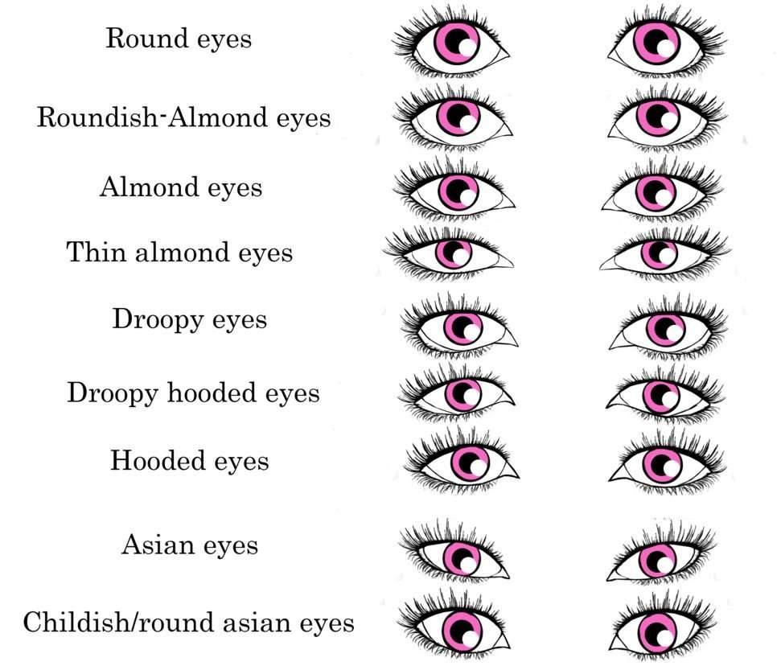
THE KINDS OF EYES

Slide 8
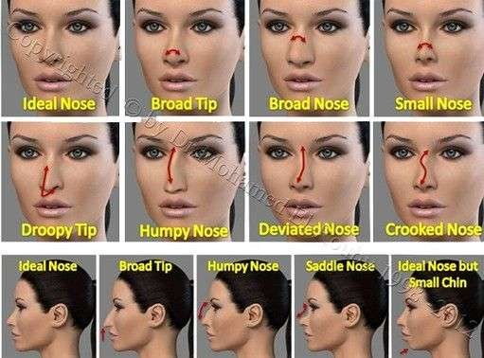
THE KINDS OF NOSE

Slide 9
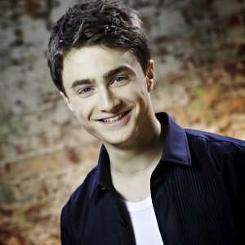
Daniel Jacob Radcliffe

Slide 10
Daniel Jacob Radcliffe
Daniel Jacob Radcliffe was born in Fulham, London, 23 July 1989. his nickname is Dan. He is the only child of Alan Radcliffe and Marcia Gresham.
Dan has white skin, dark brown hair, blue eyes, and pointed nose. His height is about 168cm. He is a loyal, shy, down to earth and humorous
Identification
Description
person. He somewhat
is also intelligent and
loves
and
mysterious.
He racing
football, Formula One gymnastics.

Slide 11
Daniel Jacob Radcliffe

Slide 12
To describe a person’s physical appearance, you can use the following words
Physical Appearnce
Height | Body | Age | Hair | Face | Eyes
Tall short | Slim Thin Plump Fat Skinny muscular | Young Old Teenager In 20s, 30s, 40s Middle age | Long Short Bald straight Curly Wavy Black Red brown | Round Oval Square Wrinkles Pale Bearded shaved | Big Round Blue Brown Green slanting

Slide 13
Complete the column below based on the text
Names | Physical Appearance | Characters
Daniel Radcliffe | Hair: dark brown | Loyal
 | Eyes: blue | Shy
 | Pointed nose | Humorous
 | Height: 168cm | Intelligent
 |  | mysterious

