Slide 1
BIOGRAPHY RECOUNT TEXT
BY MISS LIYAMNAH MUNTE

Slide 6
Linguistic features of biography text :
Use simple past tense
Example : He was born on August 17, in Jakarta, Indonesia.
Use time sequence
Example : His parents were divorced when he was three years old.
Focus on specific participant
Example : Abraham Lincoln was born in 1809 in Kentucky (USA). He worked on the farm of his father.
Use action verb
Example : He did different types of jobs before he settled as a highly successful lawyer.

Slide 7
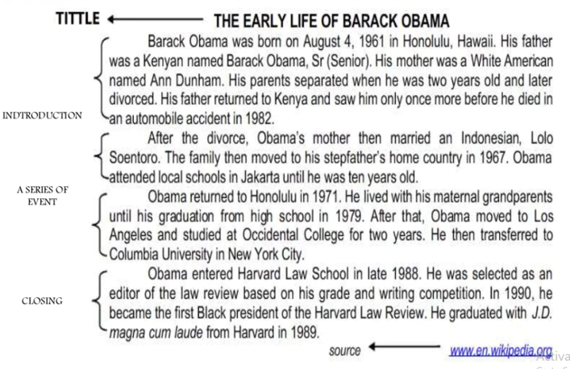

Slide 8
Let us practice

Slide 10
1. What happened in 1982?
a. Obama was born.
b. Obama’s father died.
c. Obama moved to Indonesia.
d. Obama graduated from high school.
2. The statements below are true, EXCEPT:
a. Obama’s father was not an African.
b. Obama was six years old when he moved to Jakarta.
c. Obama was the first Black President of Harvard Law Review.
d. Obama graduated from Harvard Law School with good marks.
3.When did Obama graduate from high school?
a. In 1971.
b. In 1979.
c. In 1982.
d. In 1988.
4. What does ‘he’ in paragraph 1 line 4 refer to?
a. Obama.
b. Obama’s father.
c. Obama’s mother.
d. Obama’s stepfather.

