Slide 1
ADVERTISEMENT
BY LIYAMNAH MUNTE

Slide 4
THERE ARE FOUR IMPORTANT STRATEGIC QUESTIONS IN ADVERTISEMENT
WHAT PRODUCTS WILL BE OFFERED ?
WHO WILL BE TARGET CUSTOMER?
HOW WILL THE CUSTEMERS GET THE PRODUCTS?
AT WHAT PRICE SHOLD THE PRODUCTS BE OFFERED

Slide 6
KINDS OF ADVERTISEMENT

Slide 10
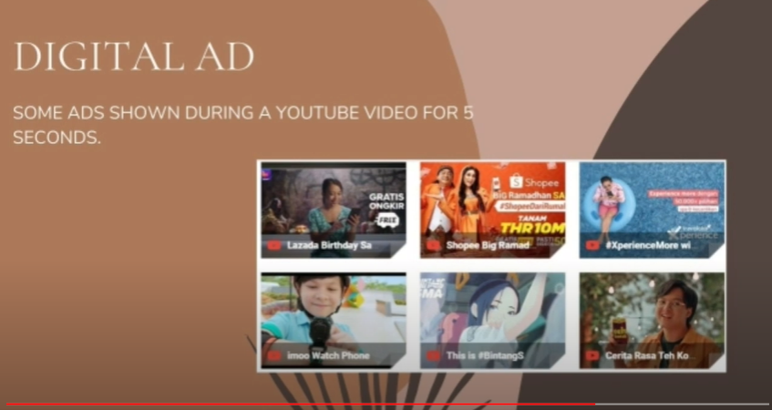

Slide 18
THANK YOU

