Slide 1
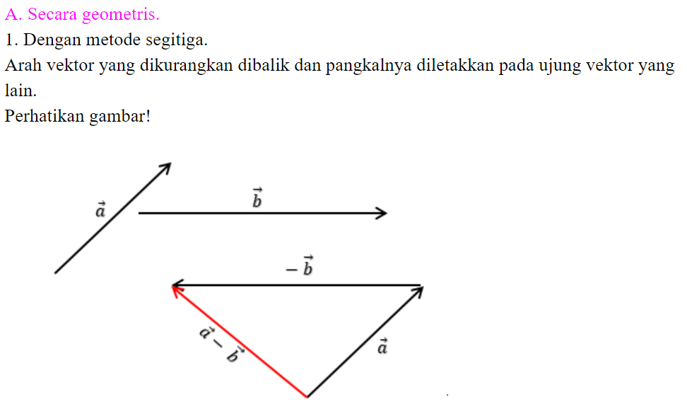

Slide 2
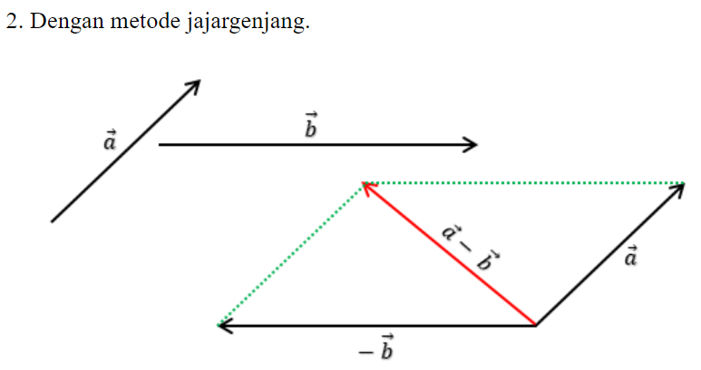

Slide 3
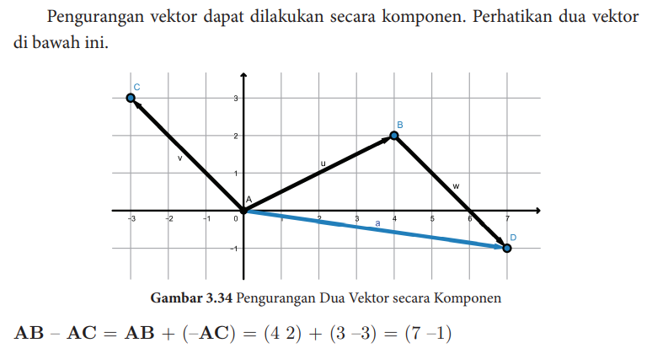
PENGURANGAN VEKTOR SECARA KOMPONEN

Slide 4
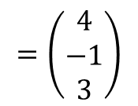
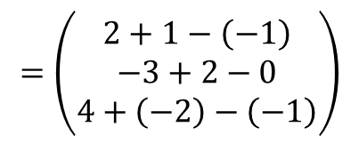
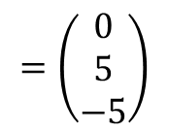
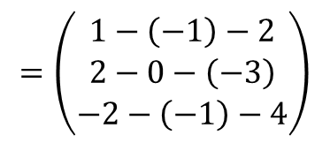
contoh soal
1. Diketahui $\vec{a}=2i−3j+4k$ dan $\vec{b}=i+2j−2k$ dan $\vec{c}=−i−k$ maka tentukan:
a. $\vec{a}+\vec{b}−\vec{c}$
b. $\vec{b}−\vec{c}−\vec{a}$
Penyelesaian
a. $\vec{a}+\vec{b}−\vec{c}=\left(\begin{aligned}2 \\ −3 \\ 4\end{aligned}\right)$+ $\left(\begin{aligned}1 \\ 2 \\ −2\end{aligned}\right)−\left(\begin{aligned}−1 \\ 0 \\ −1\end{aligned}\right)$
b. $\vec{b}−\vec{c}−\vec{a}=$ $\left(\begin{aligned}1 \\ 2 \\ −2\end{aligned}\right)−\left(\begin{aligned}−1 \\ 0 \\ −1\end{aligned}\right)−\left(\begin{aligned}2 \\ −3 \\ 4\end{aligned}\right)$
$$=\left(\begin{aligned}2+1−\left(−1\right) \\ −3+2−0 \\ 4+\left(−2\right)−\left(−1\right)\end{aligned}\right)$$
$$=\left(\begin{aligned}1−\left(−1\right)−2 \\ 2−0−\left(−3\right) \\ −2−\left(−1\right)−4\end{aligned}\right)$$
$$=\left(\begin{aligned}4 \\ −1 \\ 3\end{aligned}\right)$$
$$=\left(\begin{aligned}0 \\ 5 \\ −5\end{aligned}\right)$$

Slide 5
2. Diketahui titik A(-3, -2), B(4, -3), C(1, 1), dan D(-2, 5). Jika $\vec{p}=\vec{AB}$ dan $\vec{q}=\vec{DC}$ maka tentukan:
a. $\vec{p}−\vec{q}$
b. $\left|\vec{p}−\vec{q}\right|$
Penyelesaian
a. $\vec{p}=\vec{AB}$
Jadi
$\vec{p}−\vec{q}=$ $\left(\begin{aligned}7 \\ −1\end{aligned}\right)−\left(\begin{aligned}3 \\ −4\end{aligned}\right)$
b. $\left|\vec{p}−\vec{q}\right|=\sqrt{4^{2}+3^{2}}$
$$=\vec{OB}−\vec{OA}$$
$$=\left(\begin{aligned}4 \\ 3\end{aligned}\right)$$
$$=\sqrt{16+9}$$
$$=\left(\begin{aligned}4 \\ −3\end{aligned}\right)−\left(\begin{aligned}−3 \\ −2\end{aligned}\right)$$
$$=\sqrt{25}$$
$$=\left(\begin{aligned}7 \\ −1\end{aligned}\right)$$
$$=5$$
Jadi panjang $\vec{p}−\vec{q}$ = 5 satuan
$\vec{q}=\vec{DC}$
$$=\vec{OC}−\vec{OD}$$
$$=\left(\begin{aligned}1 \\ 1\end{aligned}\right)−\left(\begin{aligned}−2 \\ 5\end{aligned}\right)$$
$$=\left(\begin{aligned}3 \\ −4\end{aligned}\right)$$

